Slide 1
Mission-Oriented Research and Innovation in the European Union
A problem-solving approach to fuel innovation-led growth
Call for Feedback

Slide 2
On February 22 2018, Professor Mariana Mazzucato presented her report on missions.
The report describes key criteria to select missions and important factors for implementation

Slide 3
In the report Professor Mazzucato outlines how missions provide a bridge, allowing broad societal challenges to be specified as mission with clear and ambitious objectives that can be met by stimulating a portfolio of research and innovation activities and supportive measures.

Slide 4
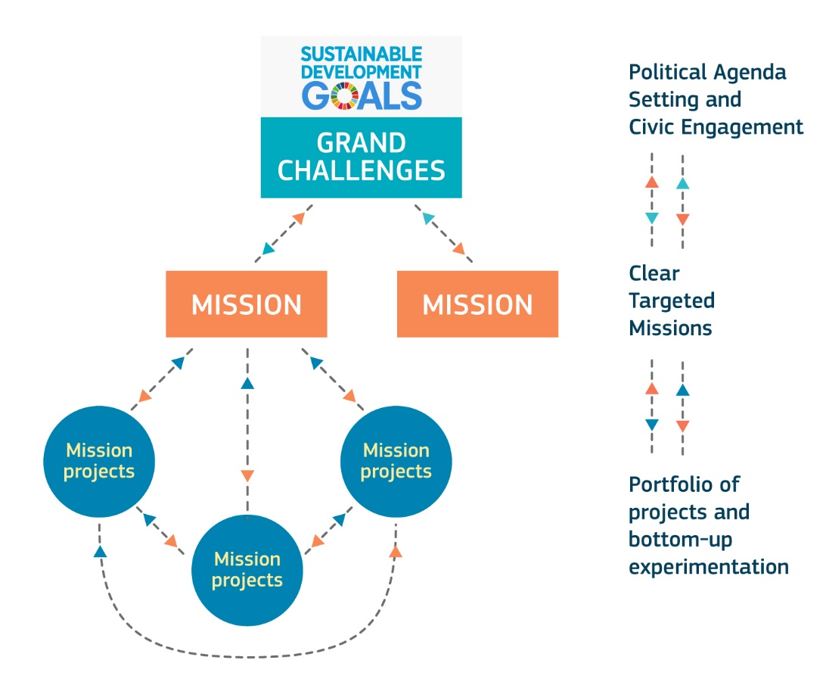
The movement from broad challenges to specific missions

Slide 5
FIVE KEY CRITERIA FOR SELECTING MISSIONS
Bold, inspirational with wide societal relevance
A clear direction: targeted, measurable and time-bound
Ambitious but realistic research and innovation actions
Cross-disciplinary, cross-sectoral and cross-actor innovation
Multiple, bottom-up solutions

Slide 6
KEY FACTORS FOR IMPLEMENTING MISSIONS AT EU-LEVEL
Engagement of diverse national and regional stakeholders
Measurement and impact by goals and milestones
A portfolio of instruments to foster bottom-up solutions
Flexibility, pro-active management and building in-house capabilities

